Slide 1
LOWER KENILWORTH IMPROVEMENT DISTRICT

Slide 2
LOWER KENILWORTH IMPROVEMENT DISTRICT (LKID)
CID VS SRA
CID = CITY IMPROVEMENT DISTRICT
SRA = SPECIAL RATING AREA
THEY ARE ESSENTIALLY TWO NAMES FOR THE SAME INITIATIVE
WE HAVE OPTED FOR LKID

Slide 3
LKID
WHAT IS A CID ?
A Geographically bound area determined by the Steering Committee
To fund additional municipal services to improve/upgrade the area
Owners are willing to pay an additional property rate
A Business Plan and Budget supported by the majority of the property owners
Our area : Kenilworth Road to Wetton Road, Rosmead Ave to Railway Line
There are currently 43 CID’s in the Cape Town area

Slide 4
LKID
CID’S IMPROVE AND UPGRADE THE AREA
Improving public safety : making public areas safe for the community & visitors
Combatting grime : keeping the area clean
Environmental improvements : making a greener area
Accepting social responsibility : dealing with the homeless, vagrants, etc

Slide 5
LKID
ADVANTAGES
Everybody contributes, hence lower contributions for all
Contributions are capped
Control over own money
Money spent according to approved Business Plan
Ability to appoint own service providers
CCT collects additional rates and pays over 1/12 of budget to NPC monthly
Community sets own standards / service levels
Well governed (NPC, Legislatively compliant, AFS)

Slide 6
LKID
CID BOARD ESTABLISHED TO MANAGE NPC
Implementation of Business Plan
Compliance with Companies Act
Audited Annual Financial Statements
Regular Board Meetings
Compliance with CID legislation
Appointment of service providers

Slide 7
LKID
RESULTS OF URBAN MANAGEMENT SURVEY
Safety and Security
Cleanliness
Environment
Social Responsibility

Slide 8
LKID
RESULTS OF COMMUNITY SURVEY

Slide 9
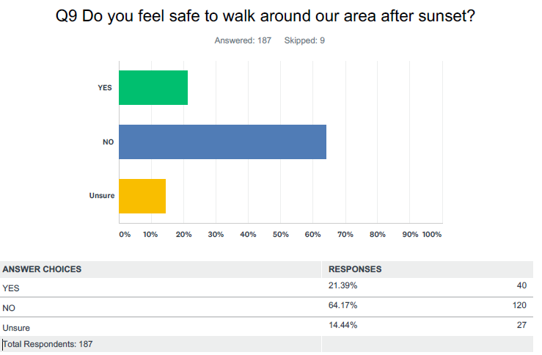
LKID
RESULTS OF UMS

Slide 10
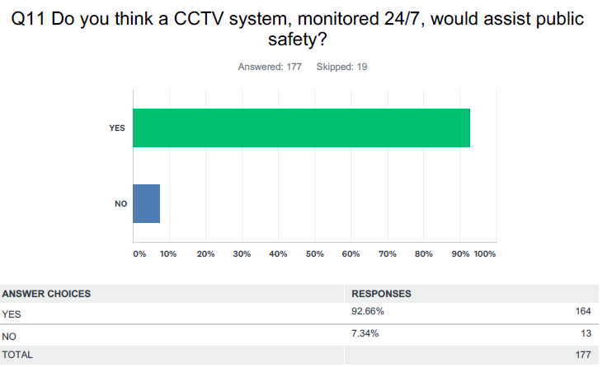
LKID
RESULTS OF UMS

Slide 11
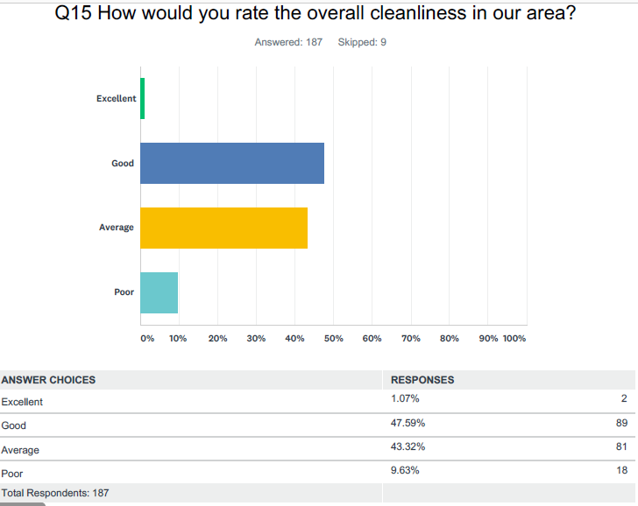
LKID
RESULTS OF UMS

Slide 12
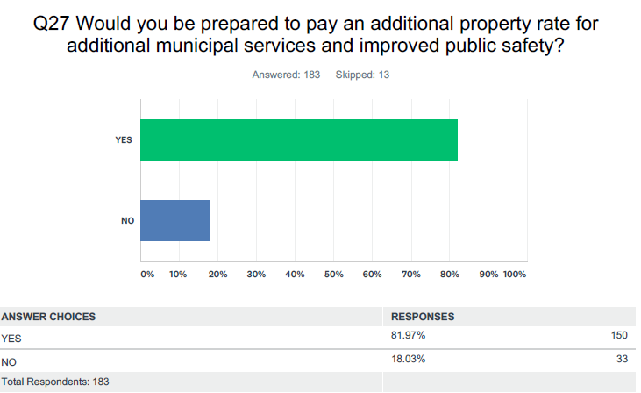
LKID
RESULTS OF UMS

Slide 13
LKID The Business Plan will deliver
Improved public safety – up to 40 cctv cameras
- 24 x 7 monitoring of the cameras
- dedicated tactical response
A cleaner neighbourhood – NGO contracting homeless
A greener neighbourhood – more trees
Urban management – repairs/reporting of damage throughout the public areas

Slide 14
LKID What is it going to cost ?
Based on a budget of R1,528 million per annum
Municipal Property Residential Contribution Non-Residential Contribution
Valuation VAT Incl VAT Incl
----------------------- ----------------------------- -------------------------------
R 1,0 million R 75 pm R 175 pm
R 1,5 million R 112 pm R 262 pm
R 2,5 million R 186 pm R 437 pm
R 5,0 million R 372pm R 875 pm
Average R 184 pm R 544 pm

Slide 15
LKID
NEXT STEPS :
Community meeting to roll out the concept – here tonight
One vote per property : greater than 60% positive required
Deadline to submit application to the City : 30 Sept
Period for objections : up to 2 months after application submitted
Council considers the application and objections
If approved : Establish a Non Profit Company (NPC)
Implementation of the Business Plan from 1 July 2020

Slide 16
LKID
ROLE OF THE CID BOARD
Implementation of the Business Plan
Compliance with the Companies Act
AGM & Board Meetings
Audited Annual Financial Statements
Compliance with CID Legislation
Appointment of Service Providers
Compliance with SARS requirements
Monthly Financial Reporting
Interact with City Departments iro service delivery

Slide 17
LKID
EXEMPTIONS FROM PAYMENT OF THE ADDITIONAL RATE
Registered owners of residential property who are senior citizens,
indigent or disabled persons qualifying for full or partial relief
Owners need to apply to the City for an exemption
If exempted can still participate, but not vote

Slide 18
LKID
QUESTIONS ?

